Slide 2


Slide 3


Connectify
LGP Challenge 2023 - SC11

Slide 4
Loss of 7.47 hours each week due to poor communication
— State of Business Communication: The Backbone of Business Is Broken

Slide 5

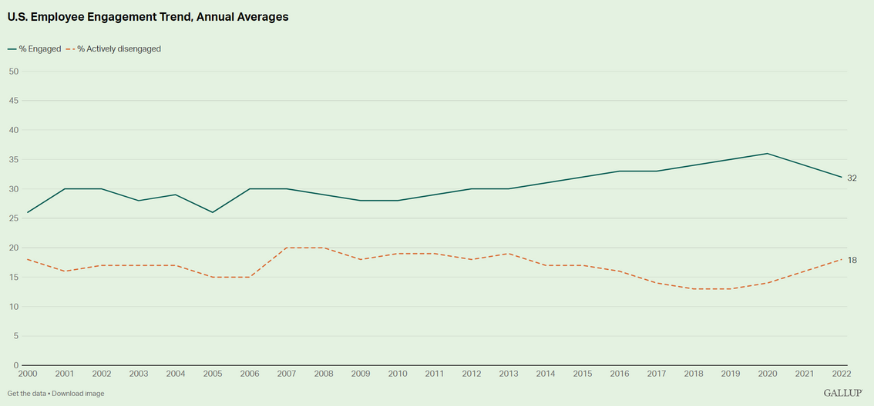
Only 32% of employees feel engaged at work
The term "employee engagement" describes a psychological commitment to one's work, team and organization.

Slide 6
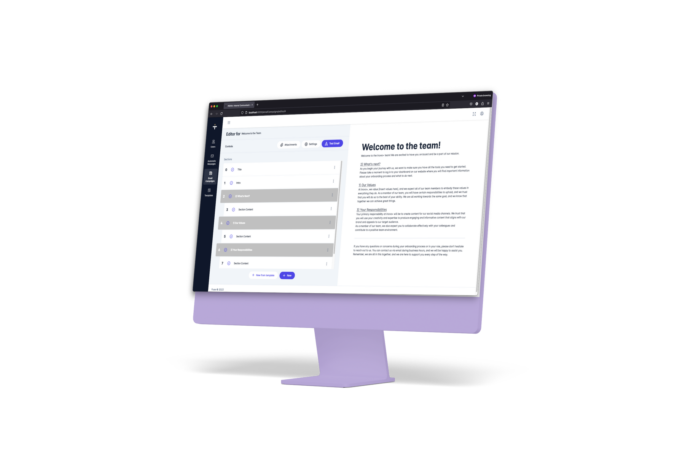
OurLive
The ultimate choice for internal communication managers to guarantee an all-in-one platform that will allow them to create and manage content that will reach and motivate all members of the company, contributing to a better business culture and worker integration.

Slide 7
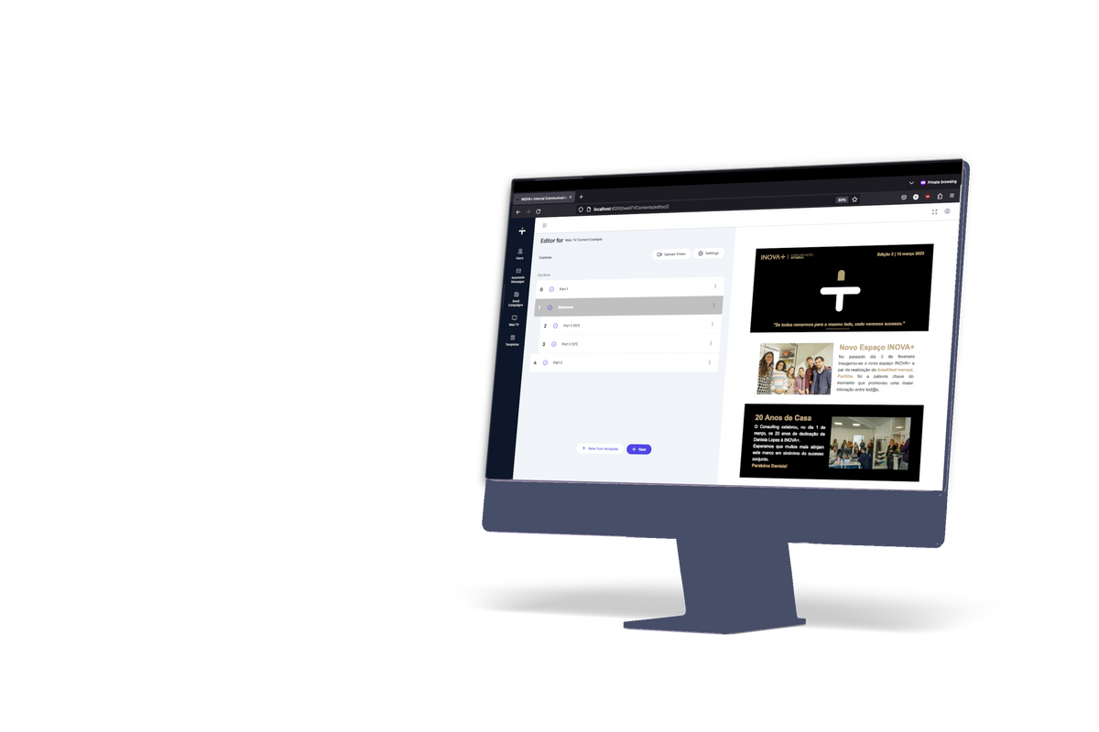
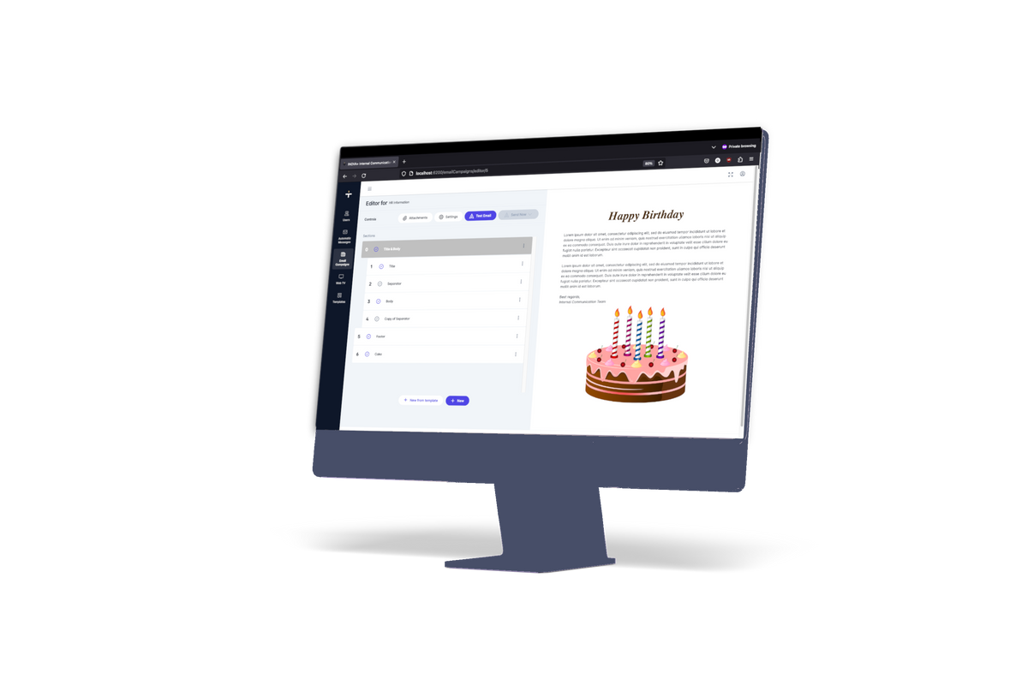
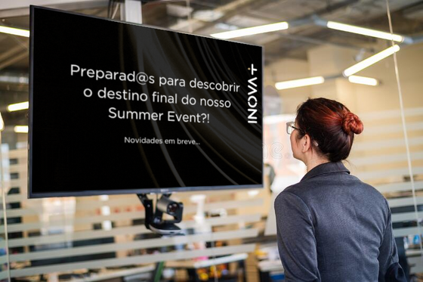
All-in-one product
Email Campaigns
WebTV Content
Automatic Messages
Create and send visually pleasing email campaigns
Create and display interesting content in the office
Send automatic customizable messages to each employee

Slide 8
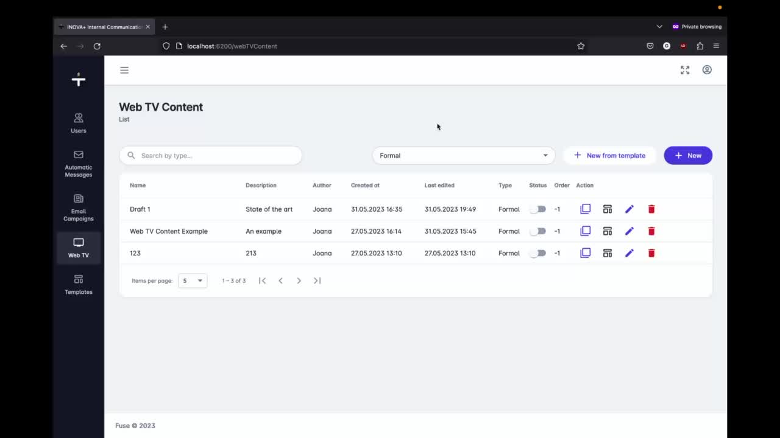

Slide 9




The internal communication team considers they were given the necessary tools to raise employee’s overall engagement with the company.

Slide 10

"Alone we can do so little;
together we can do so much."
- Helen Keller

Slide 11

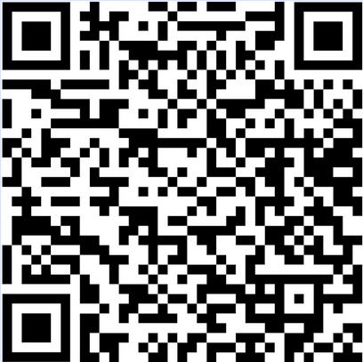
Thank you!
Any Questions?

